Slide 1
Boundary Value Analysis
In software Testing we can identify two major domains to test. Those are INPUTS & OUTPUTS.
Here for each of the domain how to use knowledge of the functional nature of a program to identify test cases for the program.
Input domain testing also called “boundary value testing” is the best-known specification-based testing technique.

Slide 2
There are two independent considerations that apply to input domain testing.
1) Normal boundary value testing
2) Considering Single Fault Assumption
Normal Boundary Value Testing is concerned only with valid values of the input variables.
Robust boundary value testing = (Invalid Variable + Valid Variable ) values together.
The second consideration is whether we make the “single fault” assumption common to reliability theory. This assumes that faults are due to incorrect values of any single variable.

Slide 3
Taken together, the Normal Boundary & Robust Boundary value analysis as the two considerations yield four variations of boundary value testing:
Normal boundary value testing
Robust boundary value testing
Worst-case boundary value testing
Robust worst-case boundary value testing
Now-a-days programing languages have accurate specification of data type(Ex: single, double, long, short) & space requirement for the performance issues.
These are also called STRONGLY TYPED languages and have boundaries explicitly mentioned inside programs for variables too, using the operators like <, >, =, ≤ and ≥.

Slide 4
Normal Boundary Value testing
All four variations of boundary value testing focus on boundary of input space with an assumption that errors tend to occur near the extreme values called boundaries (lower or upper) of an input variable.
The basic idea of boundary value analysis is to use input variable values at their:
1)minimum 2)just above minimum 3) nominal (middle) 4) just below maximum 5) maximum.
For total n variables, normal cases are obtained by holding the values of all but one variable (n-1) at their nominal values and letting that variable assume its full set of values(5 values as shown above).

Slide 5
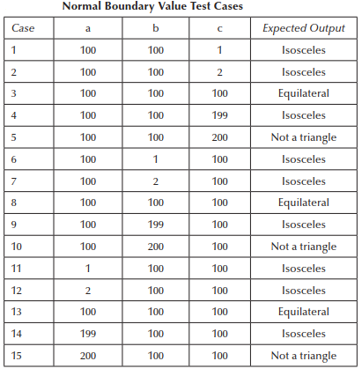
For a Triangle Problem, the 3 sides constitute 3 variables a, b, c with the boundaries min=1 and max-200. The result in Expected output we can observe in table below.

Slide 6
Robust Boundary Value testing:
The next boundary value analysis is based on a critical assumption; it is known as the “single fault” assumption in reliability theory. (That says that failures are only rarely the result of the simultaneous occurrence of two (or more) faults.
Robust boundary value testing is a simple extension of normal boundary value testing. I.e. (5 boundary values) + (1 value slightly greater than the maximum (max+) ) AND / OR (1 value slightly less than the minimum (min–)) = 7 Values
Most of the boundary value analysis applies directly to robustness testing, especially it is not with the inputs inside the boundary, but what happens when a physical quantity exceeds its the maximum?
If a variable is defined to be within a certain range, values outside that range result in run-time errors that abort normal execution.
It is better to perform explicit range checking to deal with “robust values” by the use of exception handling.

Slide 7
Generalizing Boundary Value Analysis
The basic boundary value analysis technique can be generalized in two ways:
I. By the number of variables
II. By the kinds of ranges
Generalizing by the number of variables:
If we have a function of n variables, we hold all but one at the nominal values
Let the remaining variable assume the min, min+, nom, max–, and max values.
Repeating this for each variable.
Based on this Boundary Value Analysis yields in total
4n+ 1 unique test cases
If T is total test cases, It is implied that (T-1) test cases are of single fault assumption.

Slide 8
Generalizing by the kind of range:
In a language that supports user-defined types (like C++, C#, Java), we could define the variable month as an enumerated type {Jan., Feb., …, Dec.} i.e Jan=1 Feb=2 and so on.
When no explicit bounds present, like temperature, pressure, load, speed or as in the triangle problem, we usually have to create “artificial” bounds.
In both of the above boundaries, the values for min, min+, nom, max–, and max can be derived from the context.
Boundary value analysis does not make sense over here as Boolean variables assume only 2 extremes, TRUE and FALSE without min+1 & max-1 present.

Slide 9
Limitations of Boundary Value Analysis
Boundary value analysis works well when there are independent variables representing bounded physical quantities & for every pair of variables <a, b> values, it is possible to say that a ≤ b or b ≤ a.
Examples like : Sets of car colors or temperature measure, distance covered etc., the boundary value testing is not suitable.
Boundary value analysis test cases derived from extremes of bounded, independent variables that refer to physical quantities, with no consideration of the nature of the function, nor of the semantic meaning of the variables are of no use in real-time application.
Ex: NextDate program less stress on finding February and leap year, more on boundaries of day, month and year.

Slide 10
Worst-Case Boundary Value testing
Both forms of boundary value testing, make the single fault assumption of reliability theory.
Rejecting single-fault assumption means that we are interested in what happens when more than one variable have extreme values.
For each variable, we start with the 5-element set that contains the (min+, nom, max–) + (min,max).
worst-case testing for a function of n variables generates 5^{n} test cases, as opposed to 4n + 1 test cases for boundary value analysis.
The best application for worst-case testing is where physical variables have numerous interactions, and the failure of the function is extremely costly.

Slide 11
Worst-Case Boundary Value testing
Example of the Triangle problem has 3 sides input to find out triangle formation and its type, so there are 3 variables and total worst case boundary value test cases are 125. On the next slide test cases shown are part of the total 125 test cases.
Example of the NextDate function there are 3 variables like day, month & Year. The total worst case boundary value tests are 125, like above.
Example of the Commission Problem also same as above.

Slide 12
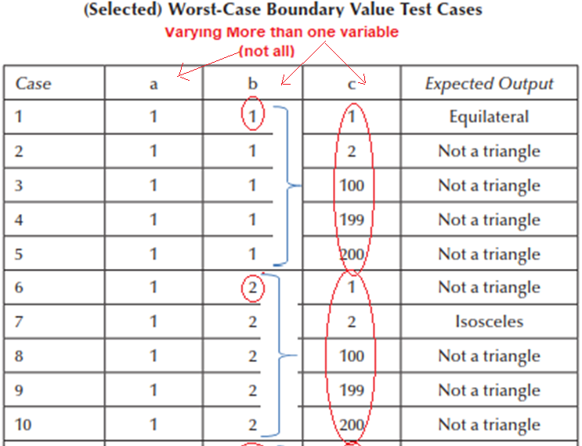

Slide 13
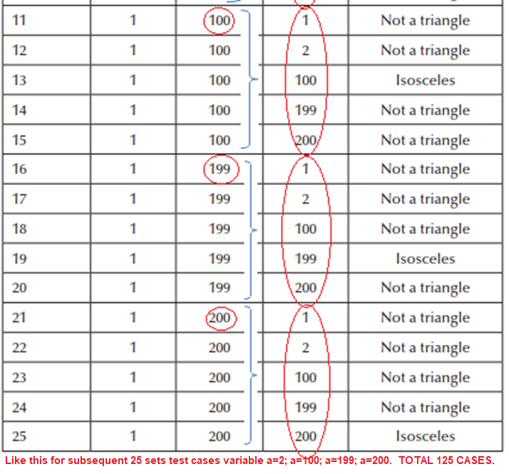

Slide 14
Robust Worst-Case Boundary Value testing
For checking the values that cross both the boundaries i.e. (min-1) and (max+1) paranoid testing, we could go to robust worst-case testing.
This involves the Cartesian product of the seven-element sets i.e. 5 (normal/worst) + 2 (Exceeding boundaries) as variables. These will form the combination for robustness testing.
This consists of 7^{n} test cases.(Where 7 types of boundaries & n is no. of variables). For triangle problem there are 343 test cases. Where there were 125 in worst-case testing.

Slide 15
Special Value testing
Special value testing occurs when a tester uses domain knowledge, experience with similar programs and information about “soft spots” to create test cases.
We might also call this as ad-hoc testing. No guidelines are used other than “best engineering judgment.” As a result, depends on abilities of the tester.
It is often results in a set of test cases that is more effective in revealing faults than the test sets generated by boundary value methods.
The acute boundary considerations in Triangle and NextDate examples alone make so many special values testing, which is not part of our text book examples.

Slide 16
Random Testing
The basic idea in Random Testing is that, rather than always choose the min, min+, nom, max–, and max values of a bounded variable, use a random number generator to pick test case values.
This avoids any form of bias in testing. It also raises a serious question: how many random test cases are sufficient?
This is usually done through the software application that uses the Random Number Generator function that picks values for a bounded variable a ≤ x ≤ b.
For each type of the output several test cases bundled together, it can be shown in percent % of the total test cases. Just an example: 35% of the total 125 test cases used to check the Isosceles triangle, shown in tabular format.

Slide 17
The table on next slide shows the results of randomly generated test cases. They are derived from a Visual Basic application that picks values for a bounded variable a ≤ x ≤ b.
The formula used here is: x = Int((b – a + 1) * Rnd + a)
Where x is output i.e. one of 4 columns (Nontriangle,scalance, Isosceles, Equilateral.
Function Int returns the integer part of a floating point number, and the function Rnd generates random numbers in the interval [0, 1].
The program keeps generating random test cases until at least one of each output occurs.

Slide 18
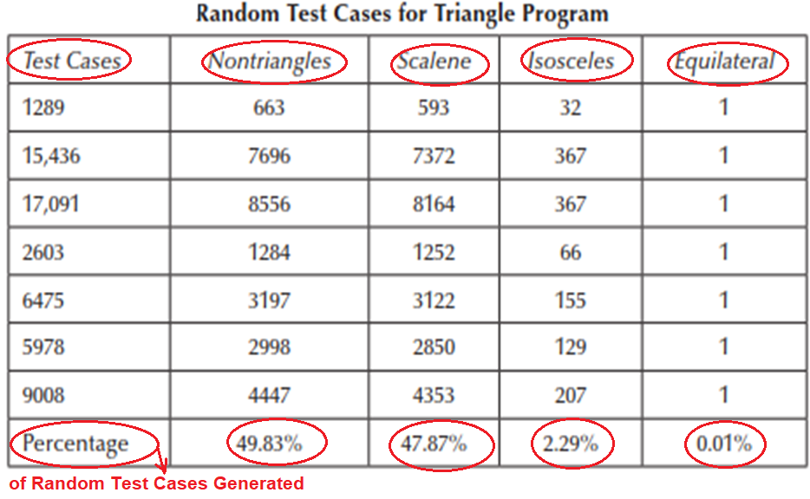

Slide 19
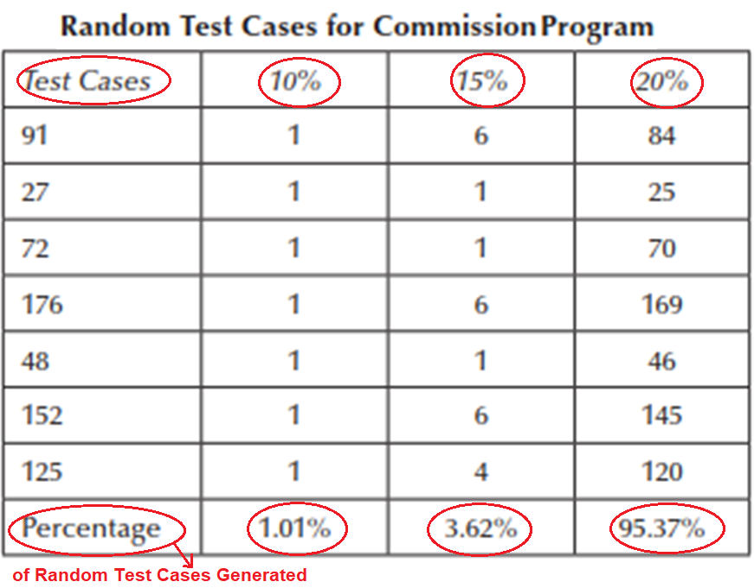

Slide 20
Guidelines for Boundary Value testing
Even though there is a relation between functions and function variables that are taken as part of the input domain testing methods, we just follow upper an lower limits specifications to devise test cases.
In most of the cases we have taken variables as independent entity. This may lead to obsolete, irrelevant and useless test cases.
The exception for above statement is ‘Special Value Testing’ where only knowledge and experience in the field are enough to device test cases.
Another useful form of output-based test cases is, a systems that generate error messages. Here the tester should device test cases to check error messages are generated at appropriate context & not falsely generated.

